Slide 1
Hello World!
WiMLDS Syracuse Presents: Data Basics Training Arc

Slide 2
Agenda: Tuesday Session
1. Introductions and Ice Breaker
2. Training Arc Details
3. Goal Setting
4. Start of Course Survey

Slide 3
Introductions
Name
What You Do
Why You’re Here

Slide 4
Course details
One-hour sessions
Lecture, workshop, and discussion sessions
Sessions WILL be recorded
Some session dates may change, keep an eye on Meetup
Sessions will build upon each other, but we will also try as much as possible to make them easy to pick and choose from

Slide 5
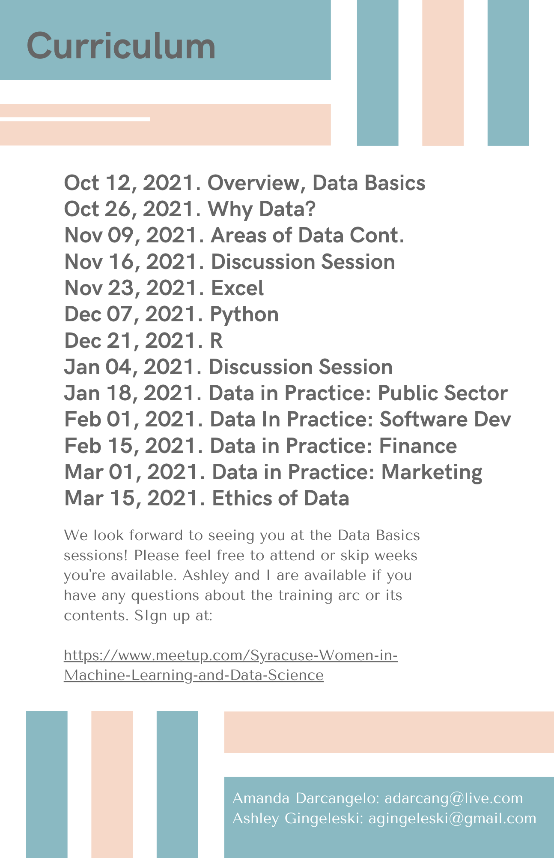
Schedule

Slide 6
Goal Setting
The purpose of this course is to introduce you to coding basics and expose you to theoretical ideas around data science and analytics.

Slide 7

Questions

